Slide 1


Implementing VPN solution with FortiGate

Slide 2

By :
1- Karim Farah
2- Ahmed El Badry
3- Islam Ramadan
4- Bola Kamal

Slide 3

What is VPN?
VPN stands for Virtual Private Network. It is a technology that creates a secure, encrypted connection over a less secure network, such as the Internet. A VPN protects data in transit, enables private communication, and allows users to securely access internal network resources from remote locations

Slide 4
Types of VPN?
Site-to-Site
- VPN Connects two networks securely over the internet.
- Common in branch offices.
Remote Access VPN
- Allows individual users to connect to a private network remotely.
SSL VPN
- Uses SSL protocol to provide secure remote access via a web browser.
IPSec VPN
- A widely used protocol suite for securing IP communications.

Slide 5
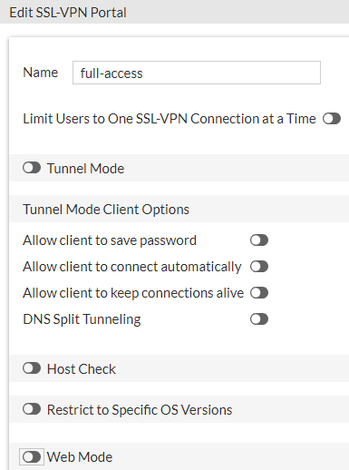
SSL VPN Deployment Modes
Tunnel mode
Accessed through a FortiClient
Requires a virtual adapter on the client host
Web mode
Requires only a web browser
Supports a limited number of protocols:
FTP, HTTP/HTTPS, RDP, SMB/CIFS, SSH, Telnet, VNC, and Ping
VPN > SSL VPN Portals

Slide 6

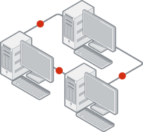


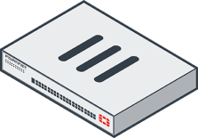

Tunnel Mode—Split Tunneling
Disabled:
All traffic routes through an SSL VPN tunnel to a remote FortiGate, then to the destination. This includes internet traffic
An egress firewall policy is required
Traffic inspection and security features can be applied
Enabled:
Only traffic destined for the private network is routed through the remote FortiGate
Internet traffic uses the local gateway; unencrypted route
Conserves bandwidth and alleviates bottlenecks
There is no traffic inspection by FortiGate
SSL VPN Tunnel
Split tunneling enabled
Split tunneling disabled

Slide 7
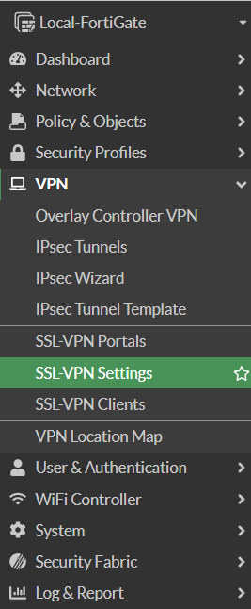
VPN concepts and configuration
VPN configuration
Set up user accounts and groups for remote SSL VPN users
Configure SSL VPN portals
Configure SSL VPN settings
Create a firewall policy to and from the SSL VPN interface
Accepts and decrypts packets
Allows traffic from SSL VPN clients to the internal network and the reverse
Optionally:
Create a firewall policy to allow SSL VPN traffic to the internet:
Useful to allow all clients traffic through FortiGate to internet when split tunneling is disabled
You can use FortiGate to apply security profiles
4
5
2
3
1

Slide 8
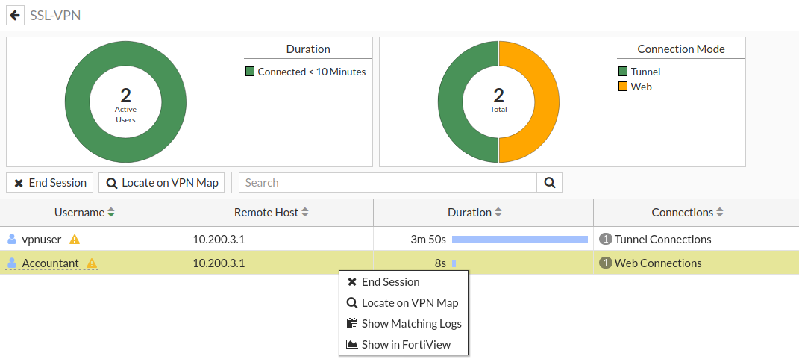
Monitoring SSL VPN Sessions
Monitor which SSL VPN users are connected
GUI: Dashboard > Network > SSL VPN
Shows SSL VPN user names, connection times, and IP addresses
For tunnel mode, Active Connections displays IP address assigned to fortissl virtual adapter
Force end user disconnection
Right-click the user name and select End Session
Dashboard > Network > SSL VPN
Tunnel mode user: shows SSL VPN IP address assigned during the session
Select or Right-click to terminate an active SSL VPN session
web user

Slide 9
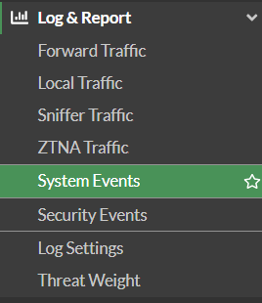
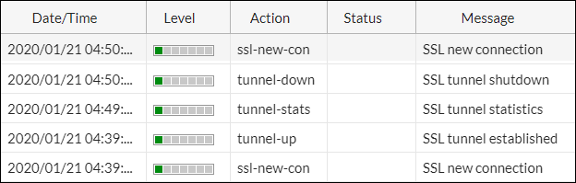
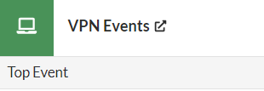

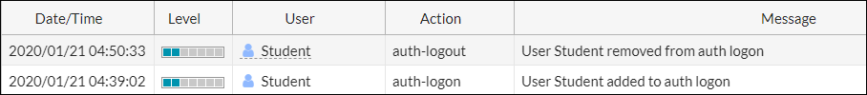
SSL VPN Logs
Review if the SSL VPN tunnel is established or closed
Review the authentication action related to SSL VPN users
Review SSL VPN connections in tunnel mode with FortiClient
Custom URL path
Custom URL path

Slide 10
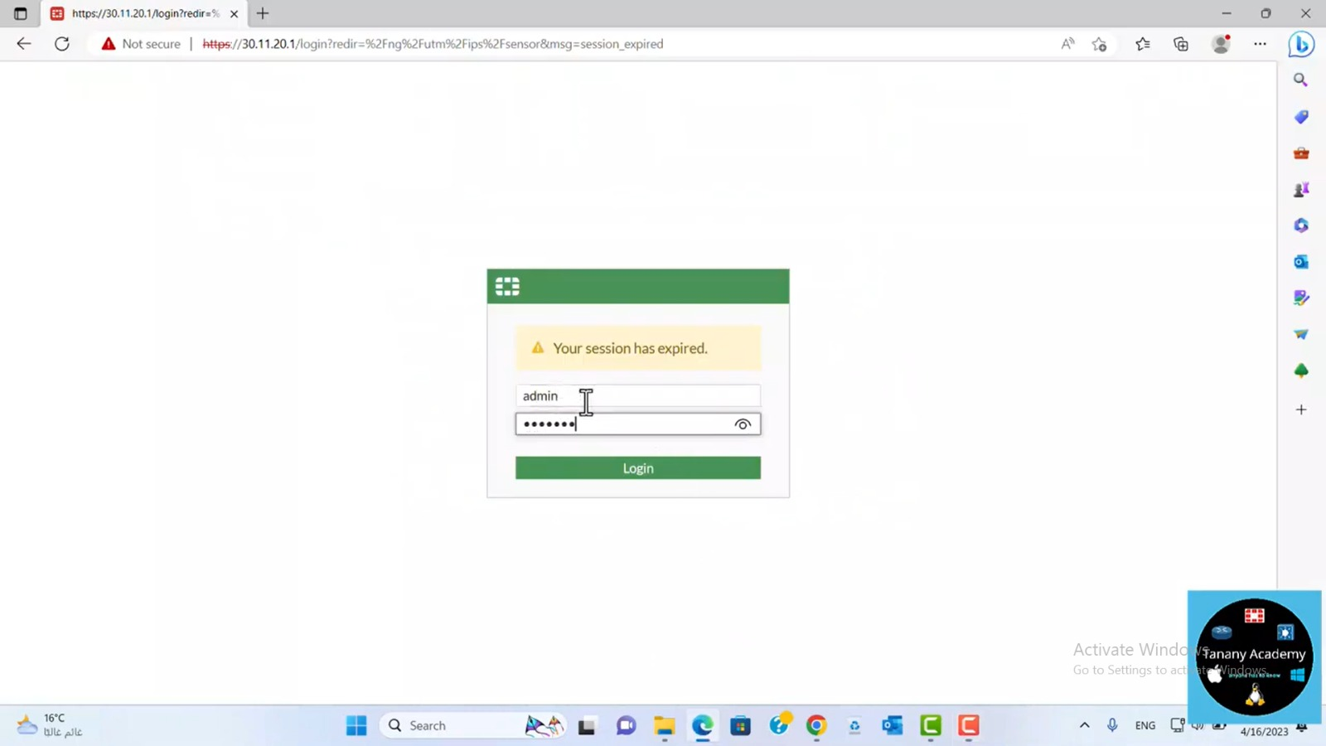

Slide 11
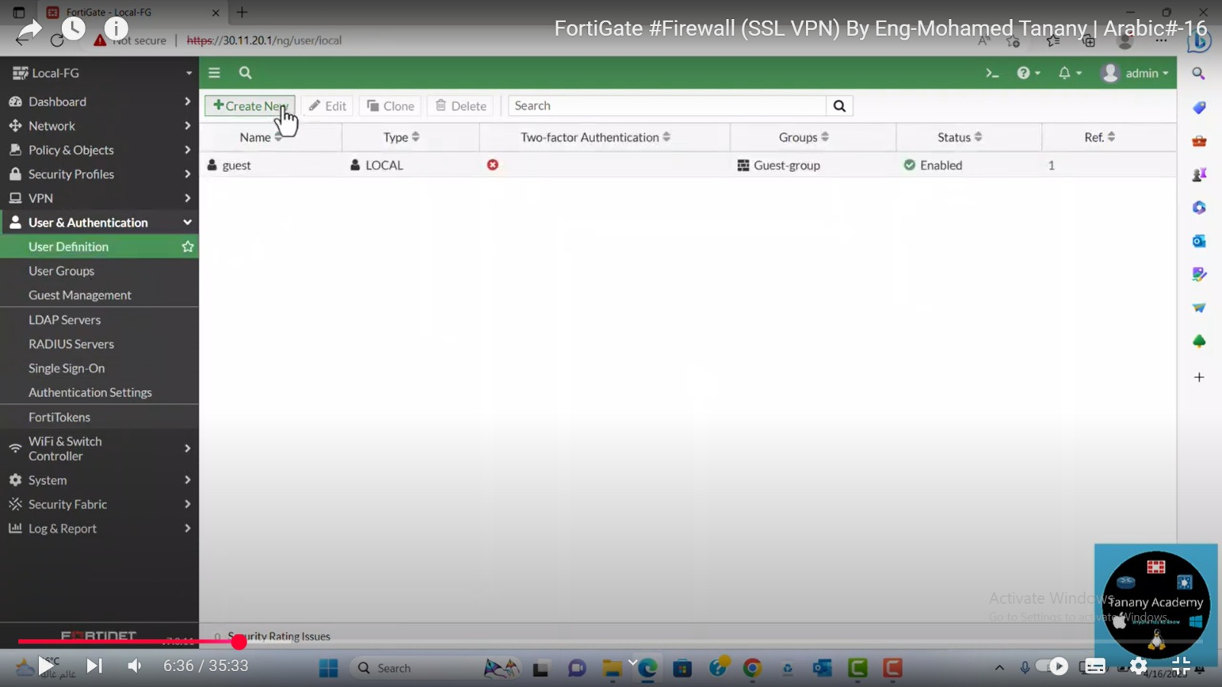

Slide 12
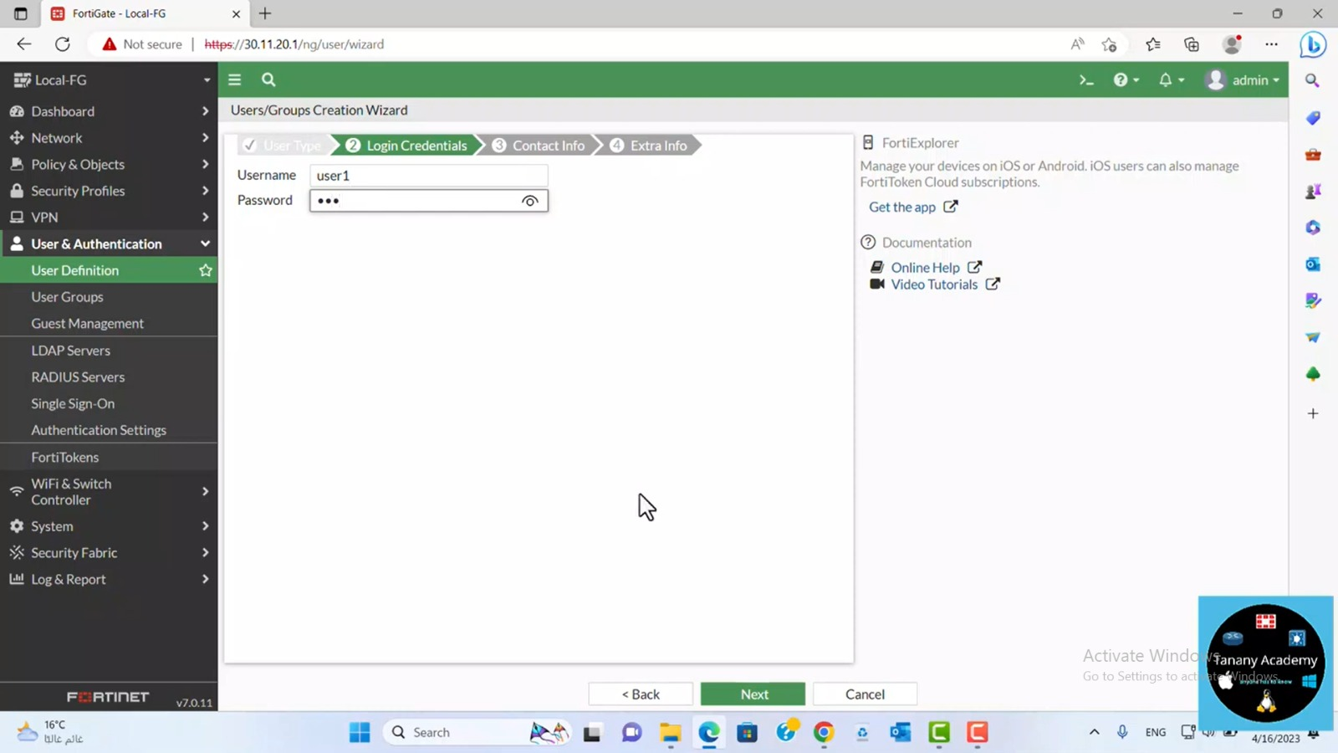

Slide 13
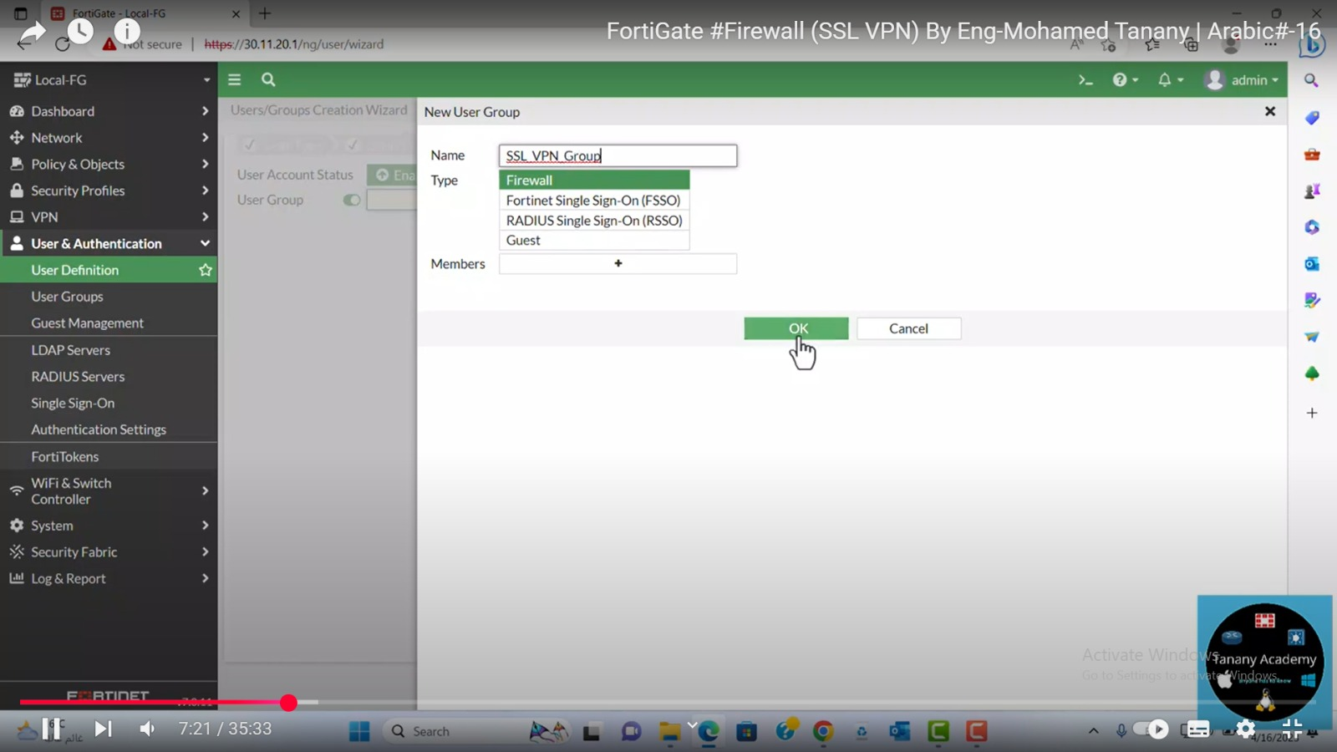

Slide 14
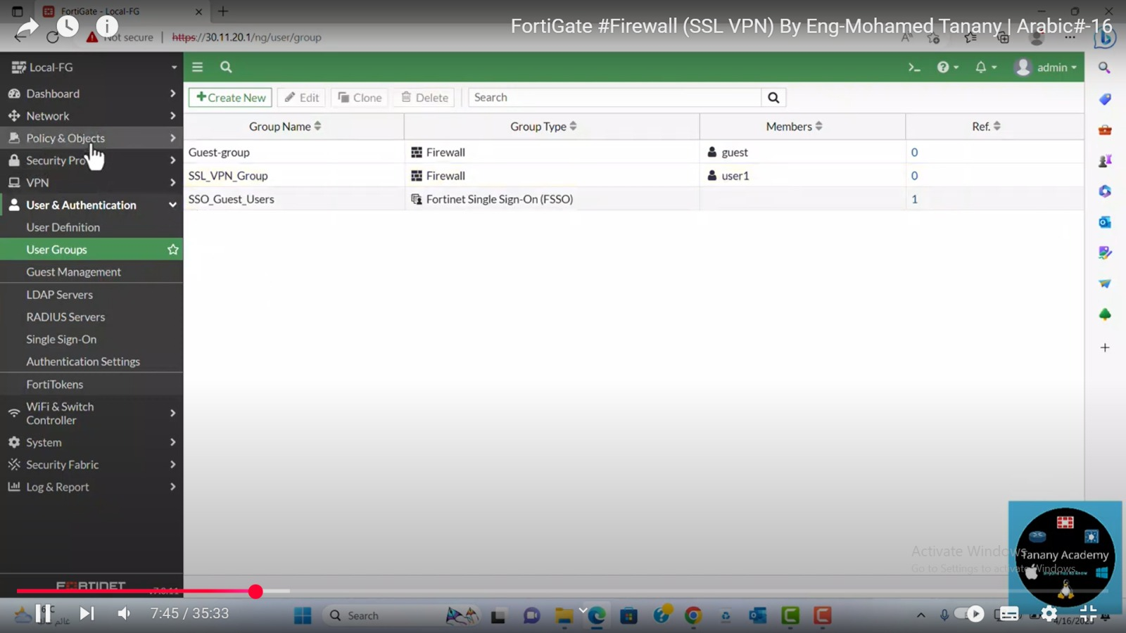

Slide 15


Slide 16
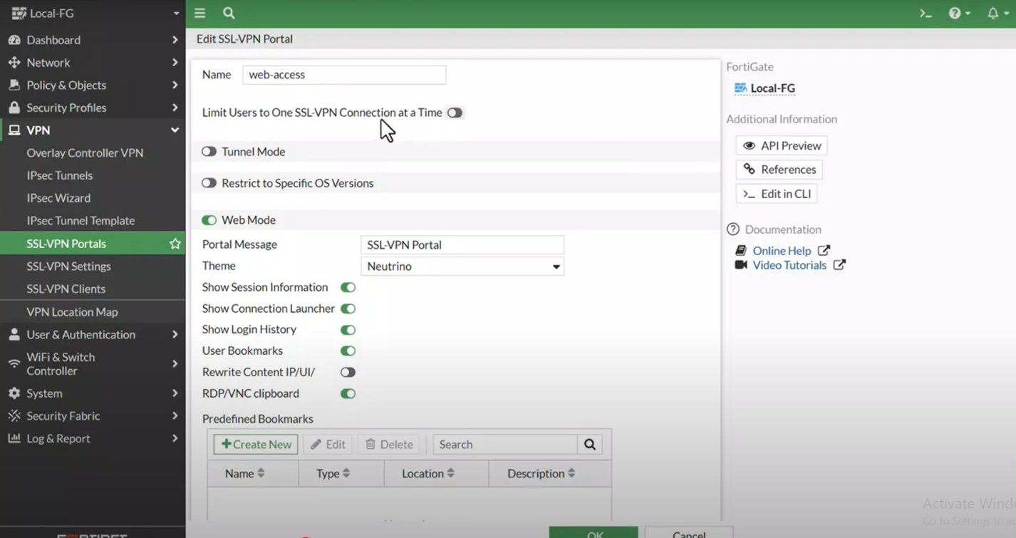

Slide 17
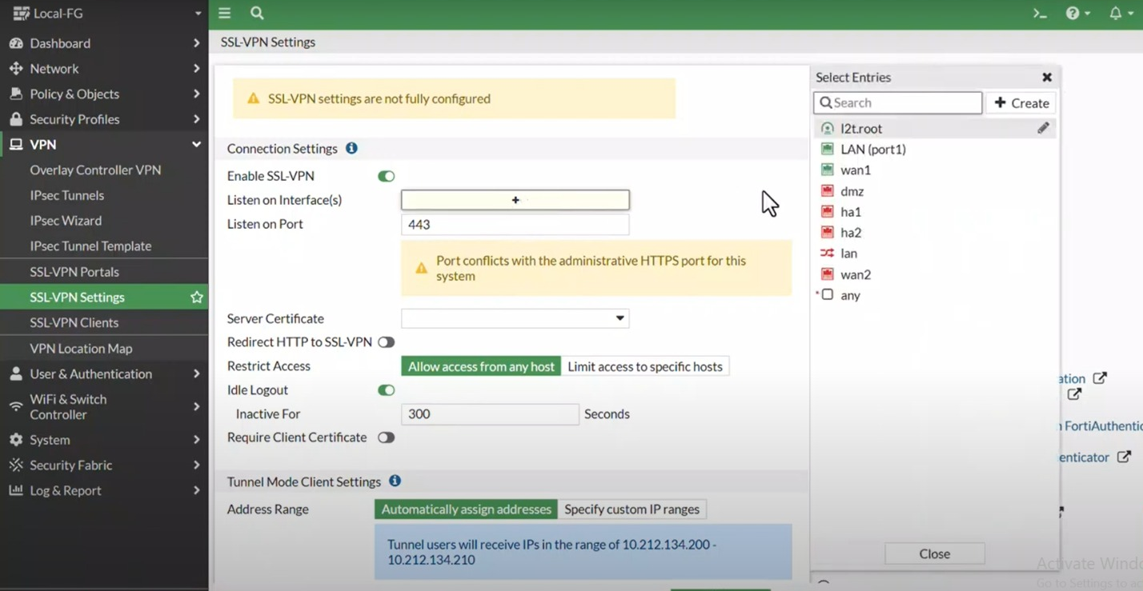

Slide 18
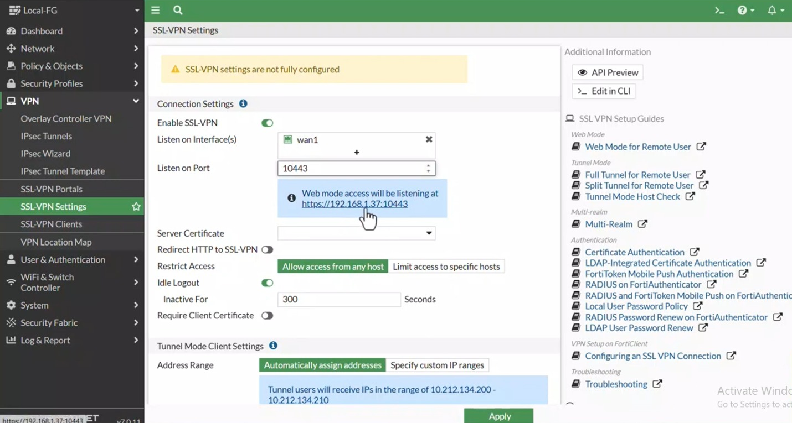

Slide 19
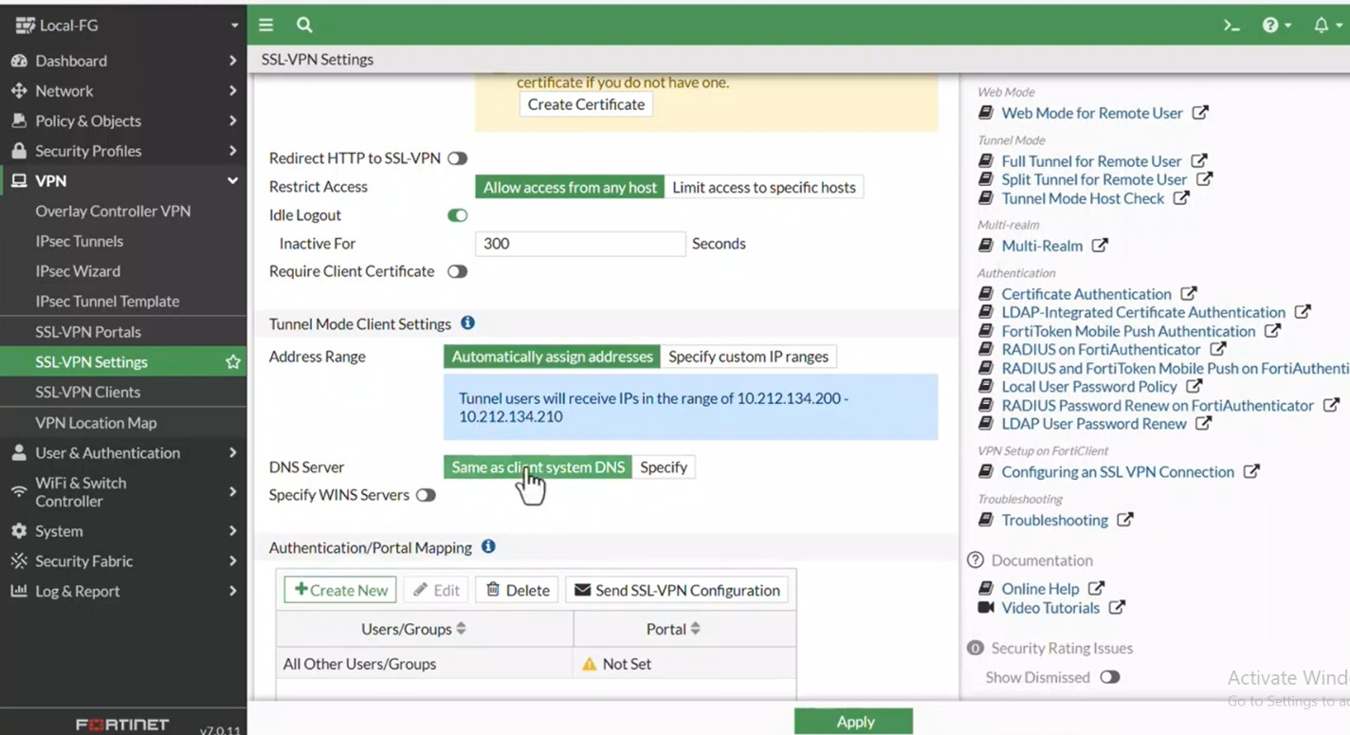

Slide 20
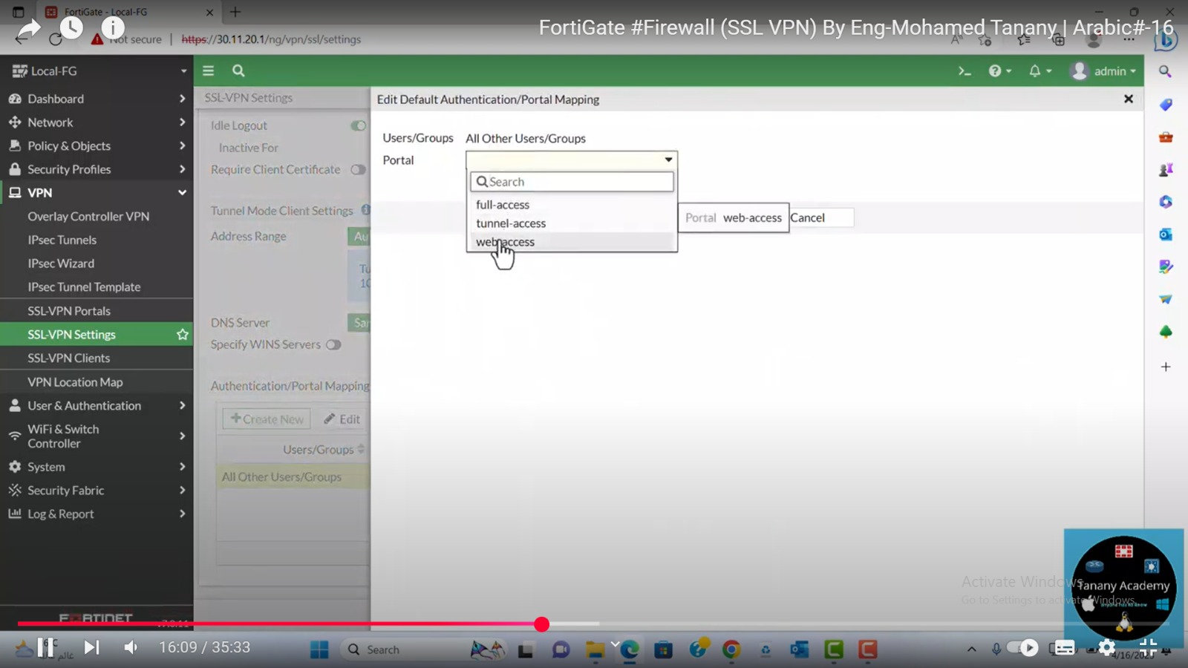

Slide 21
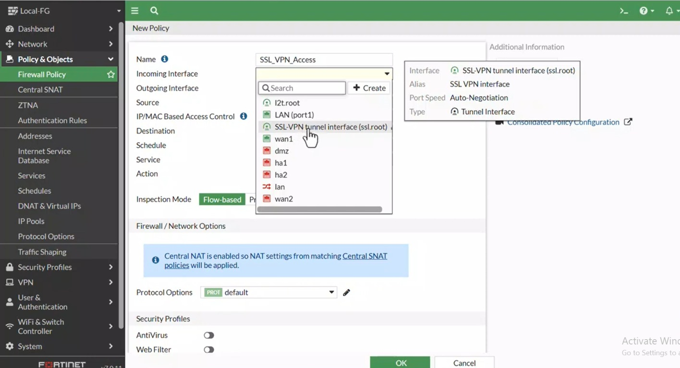

Slide 22
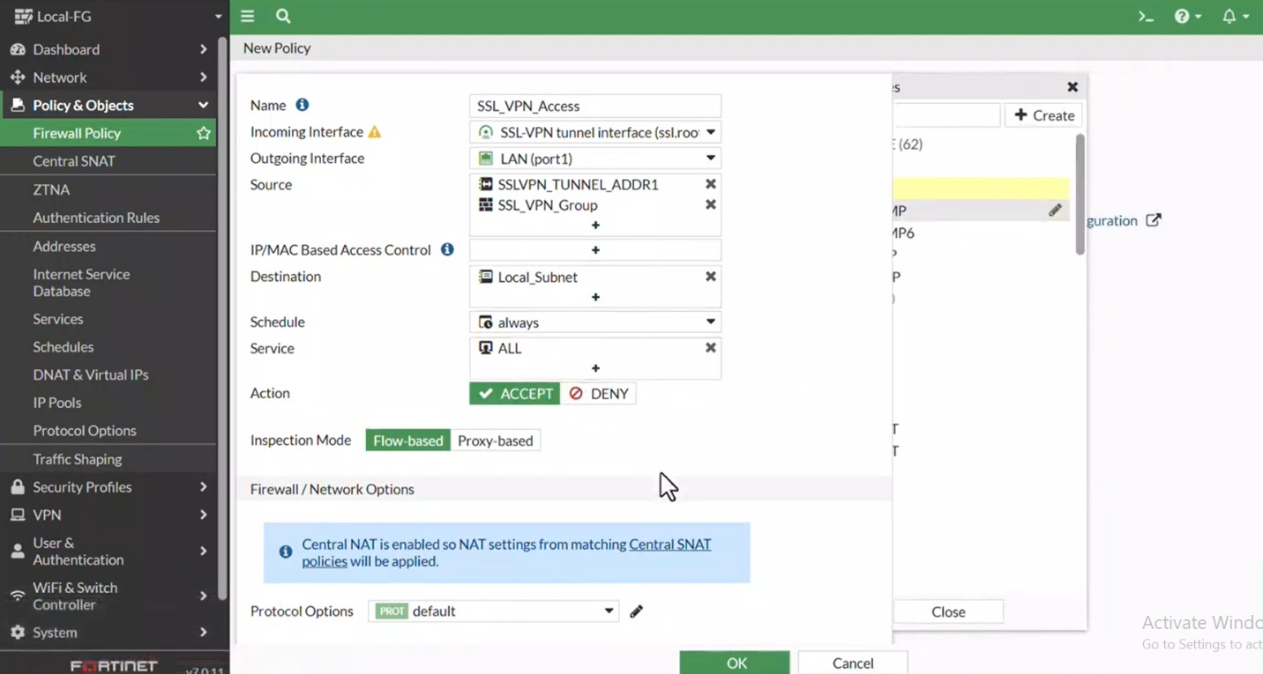

Slide 23
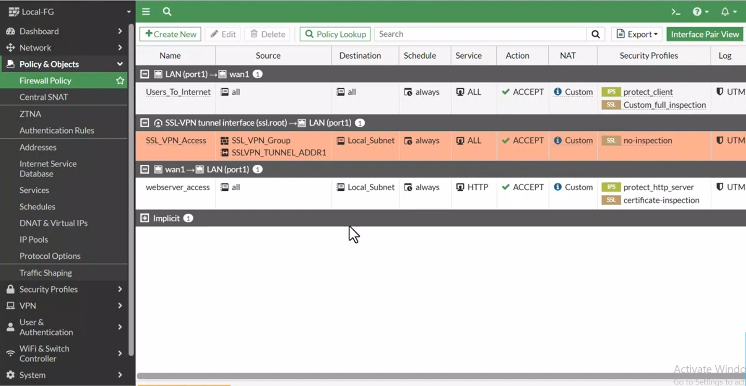

Slide 24
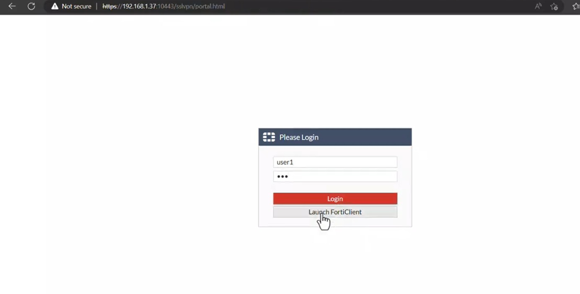

Slide 25
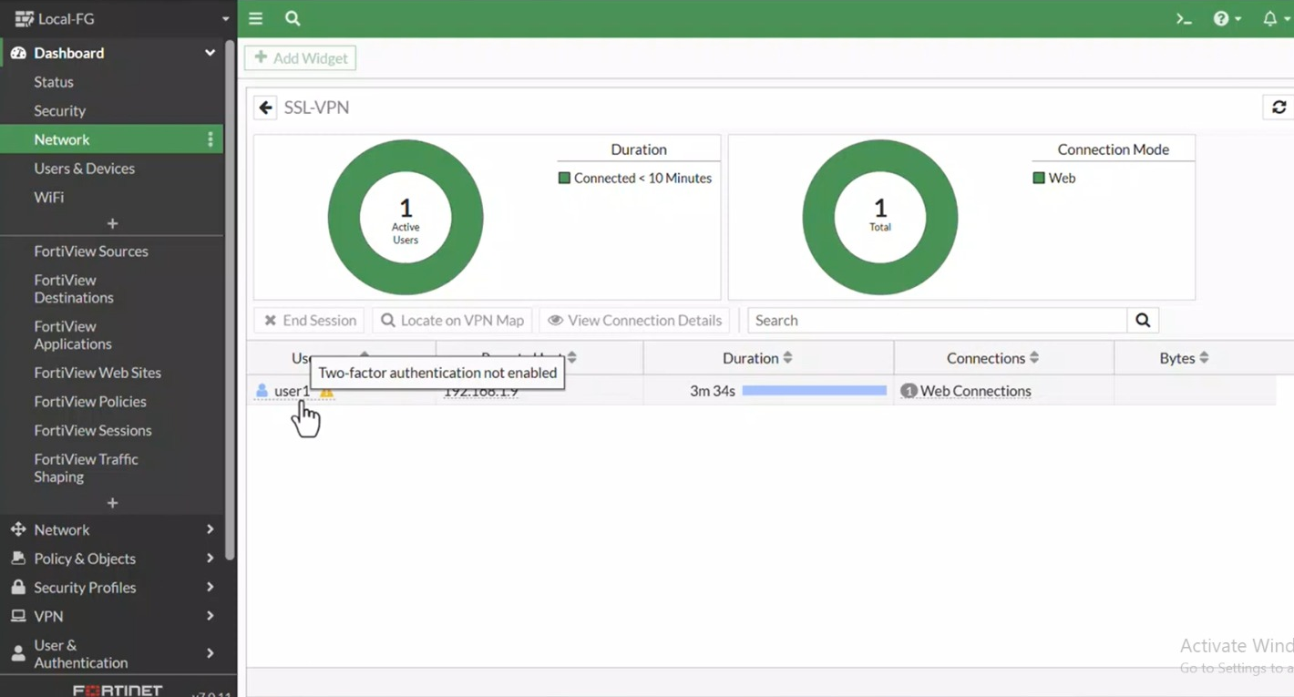

Slide 26
IPSec VPN
VPN concepts and configuration
What is IPSec?
IPSec Components
FortiGate Firewall Overview
IPSec VPN Types in FortiGate
Configuration

Slide 27
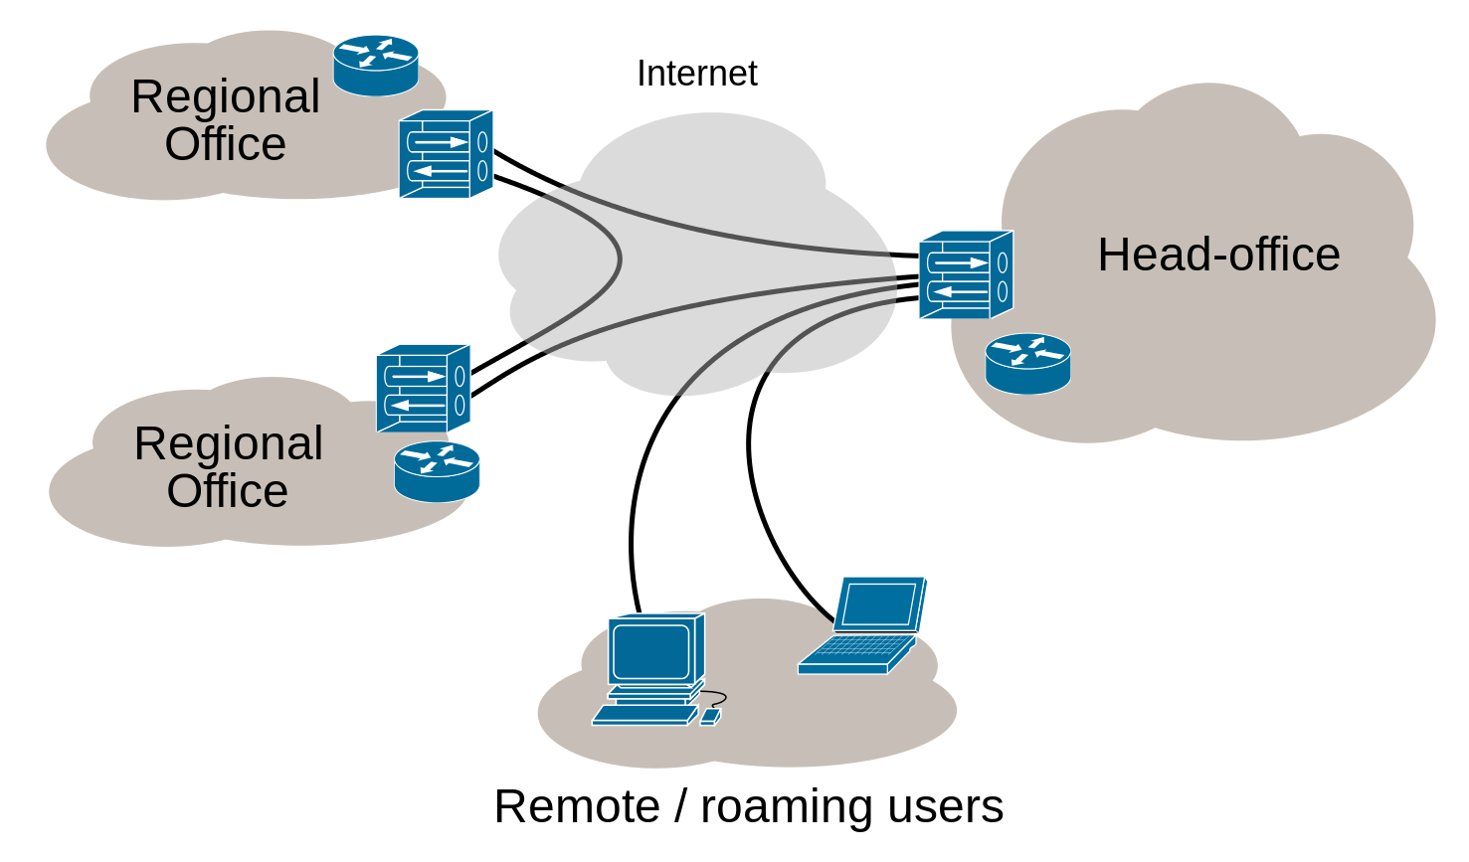
What is IPSec?
Definition: Internet Protocol Security (IPSec) ensures secure communication over IP networks.
Key Features:
Confidentiality (Encryption)
Data Integrity
Authentication
Use Cases: Site-to-site VPNs, Secure Remote Access

Slide 28
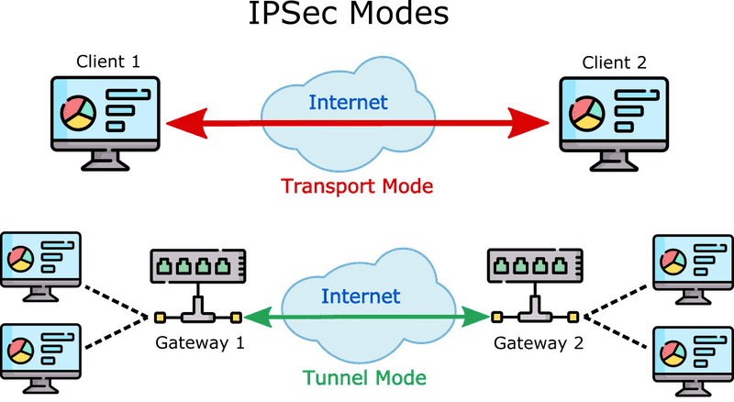
IPSec Components
Modes:
Transport Mode: Encrypts payload only.
Tunnel Mode: Encrypts entire packet (common for VPNs).
Protocols:
AH (Authentication Header): Integrity + Authentication.
ESP (Encapsulating Security Payload): Encryption + Integrity.

Slide 29
FortiGate Firewall Overview
Role in IPSec: Acts as VPN gateway for secure site-to-site tunnels.
Key Features:
High-performance encryption.
Support for policy-based and route-based VPNs.
Integrated security (firewall, IDS/IPS).

Slide 30
IPSec VPN Types in FortiGate
Policy-Based VPN:
Uses ACLs to define encrypted traffic.
Less flexible, ideal for simple setups.
Route-Based VPN:
Utilizes virtual tunnel interfaces (VTI).
Flexible, supports dynamic routing protocols.

Slide 31
Configuration Steps Overview
Phase 1: Establish secure management channel.
Phase 2: Define data encryption parameters.
Firewall Policies: Allow traffic through the tunnel.
Routing: Direct traffic to the VPN interface.

Slide 32
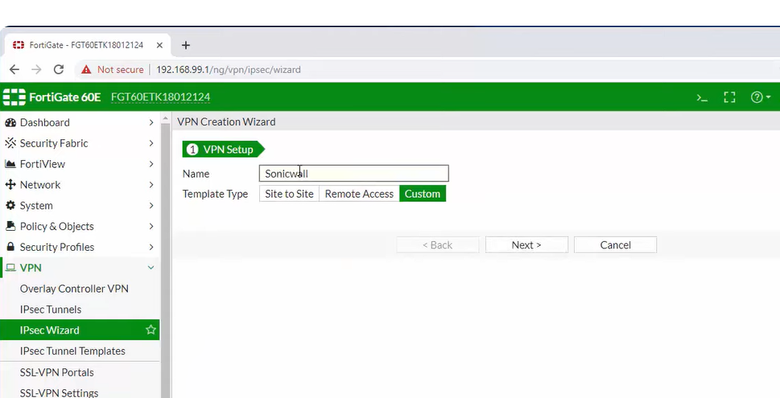
Configuration

Slide 33
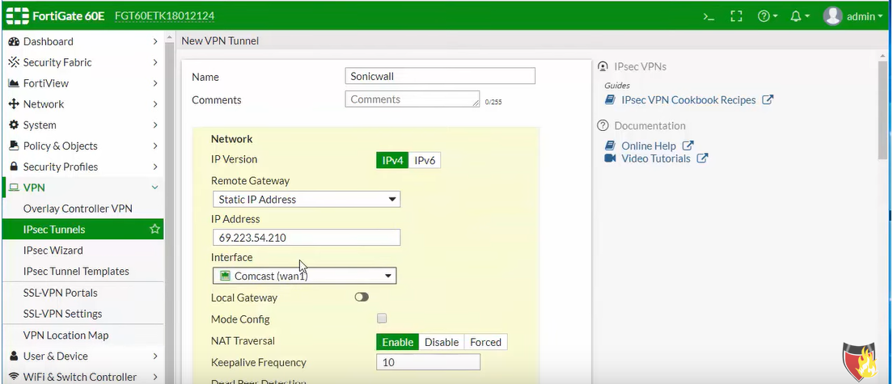
Configuration

Slide 34
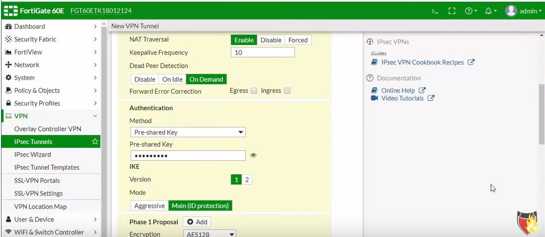
Configuration

Slide 35
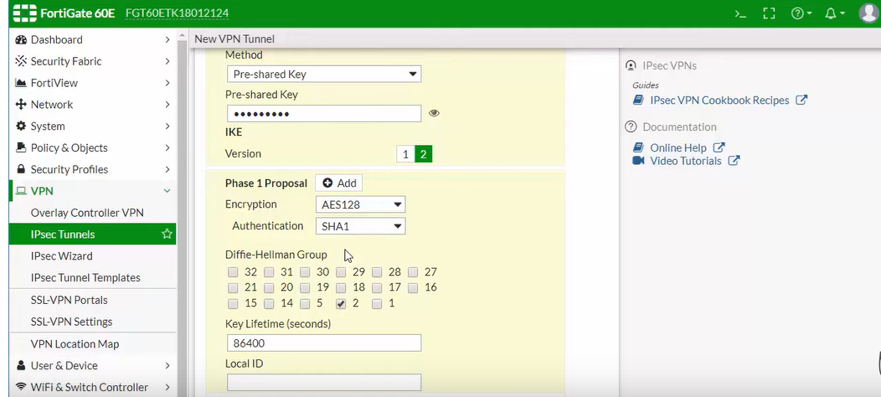
Configuration

Slide 36
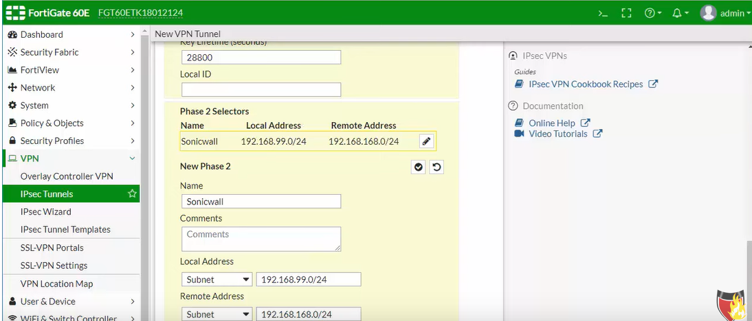
Configuration

Slide 37
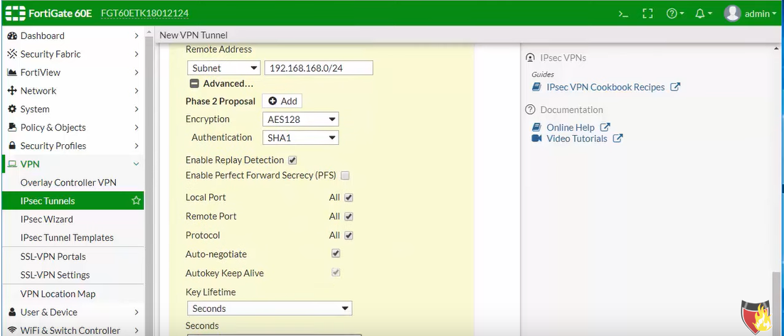
Configuration

Slide 38
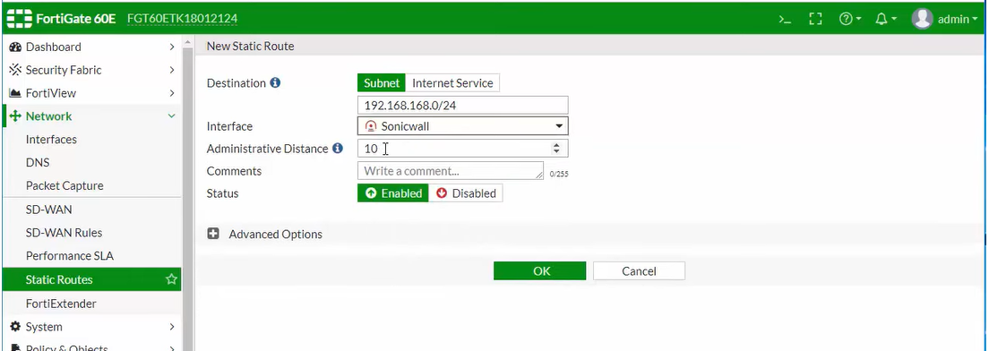
Configuration

Slide 39
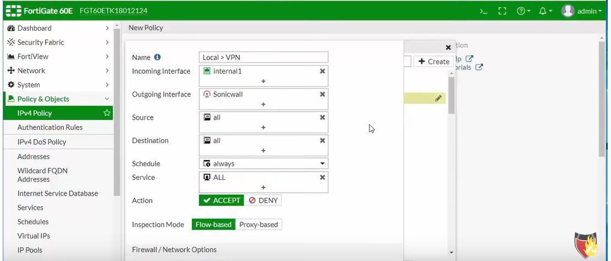
Configuration

Slide 40
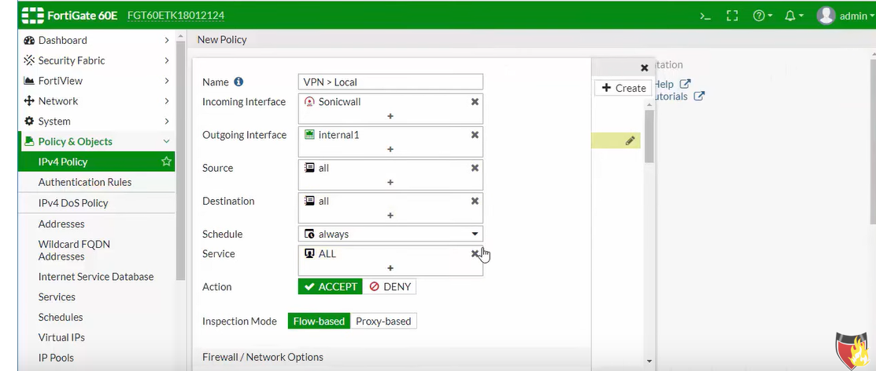
Configuration

Slide 41
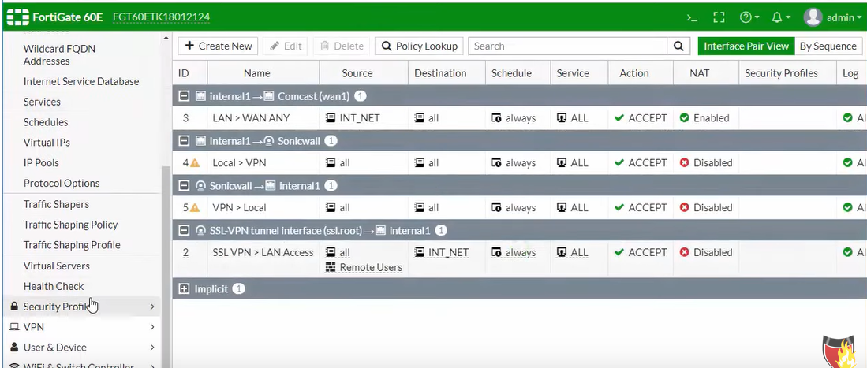
Configuration

Slide 42
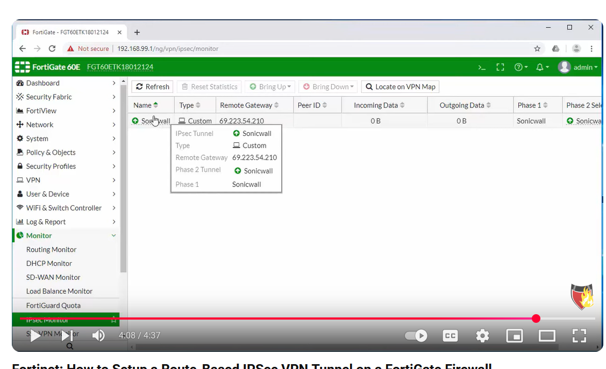
Configuration

Slide 43
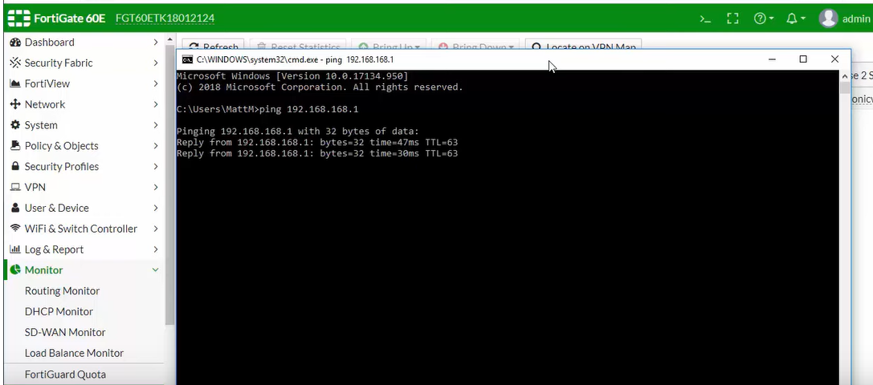
Configuration

Slide 44
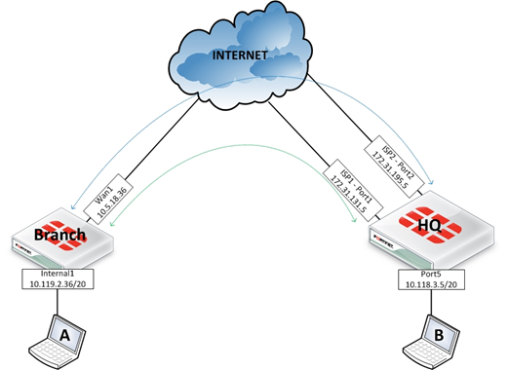
FortiGate VPN with SD-WAN
VPN concepts and configuration

Slide 45
What is SD-WAN?
SD-WAN = Software Defined Wide Area Network It means a WAN (Wide Area Network) that's managed and controlled via software, rather than traditional manual configuration.
Instead of using a single connection (like Internet/MPLS) between your branches and HQ you can use multiple internet lines and SD-WAN will automatically choose the best path, load balance traffic, or provide automatic failover.

Slide 46
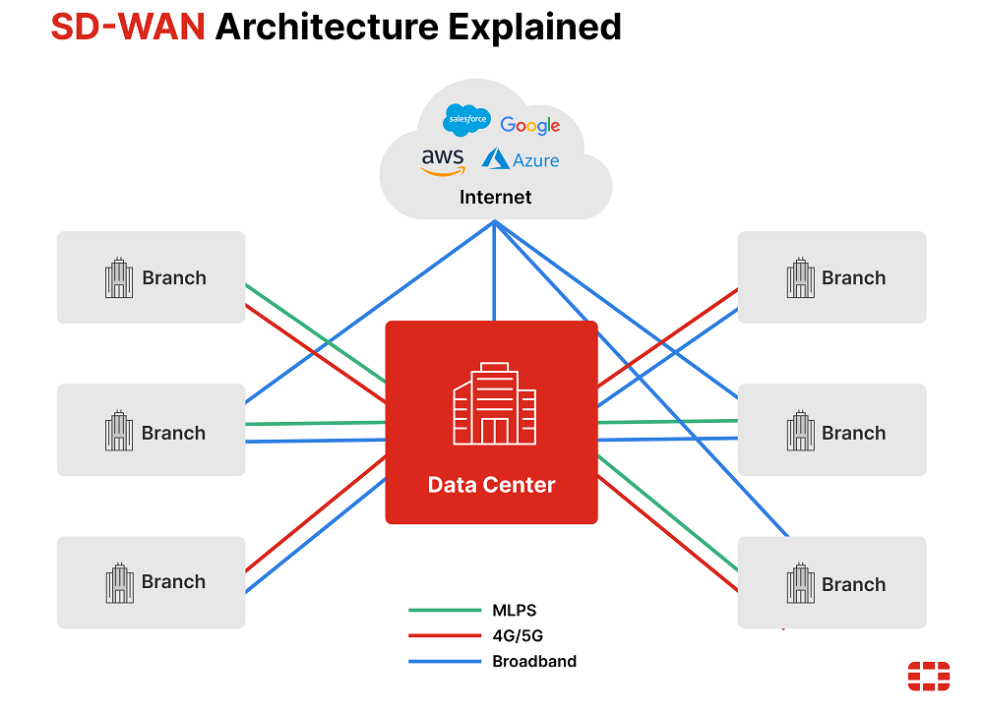
Key Benefits of SD-WAN?
Load Balancing .
Automatic Failover .
Supports VPN Easily
Monitoring & Visibility .
Traffic Control

Slide 47
SD-WAN Components :
Member 1
link1
Members / Interfaces.
Zones / Group of interfaces.
Performance SLA / Health check
(Packet Loss – Jitter – Latency ) .
Rule ( Define src –dst – apps/internet services).
link 2
SD-WAN zone
Member 2
…
Member x
link x
SD-WAN rule
Traffic matching criteria:
Src, dst, app,…
Outgoing interface selection strategy
SLA criteria

Slide 48
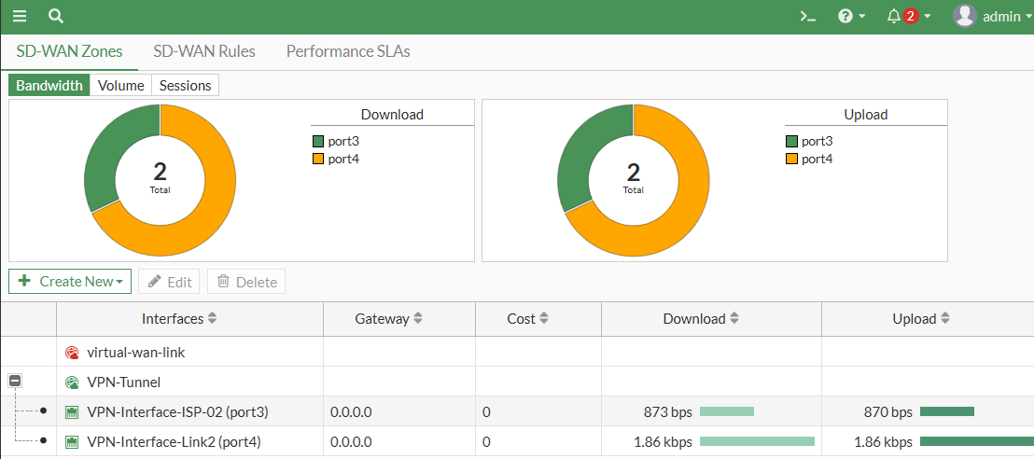
SD-WAN Zone :

Slide 49
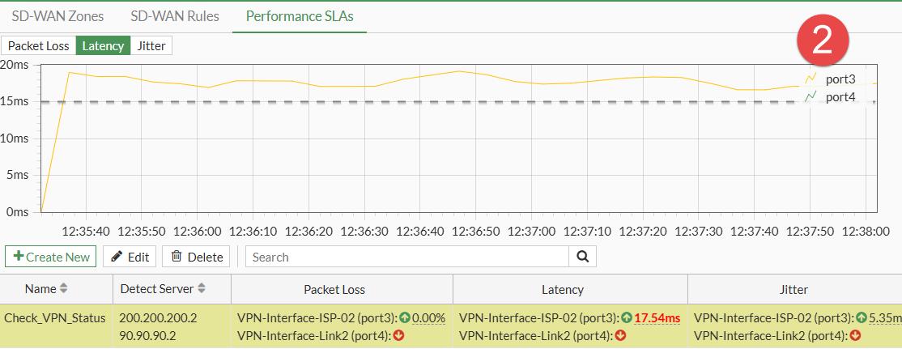
SD-WAN SLAs

Slide 50
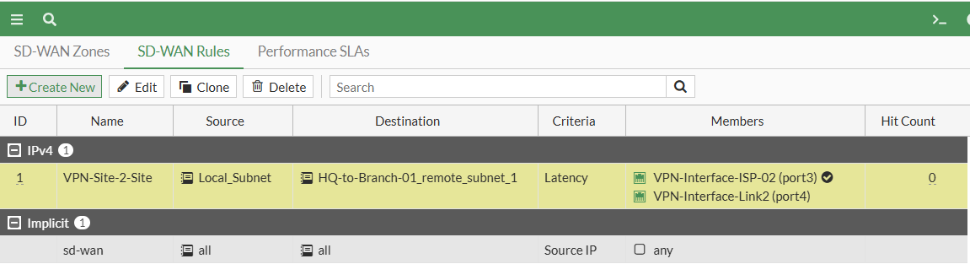
SD-WAN Rules

Slide 51
Site to Site Use Case SD-WAN
Hub and Spoke topology .
Overlay “Tunnel” & Underlay “internet” .
SD-WAN monitor and select best link
(Packet Loss – Jitter – Latency ) .
Use dynamic touting for building routing table and easy for VPN .
LAN(site0)
site0
(HUB)
T_INET
T_MPLS
T_INET
T_MPLS
T_INET
T_MPLS
site1
site2
LAN(site1)
LAN(site2)
Tunnel over Internet
Tunnel over MPLS

Slide 52
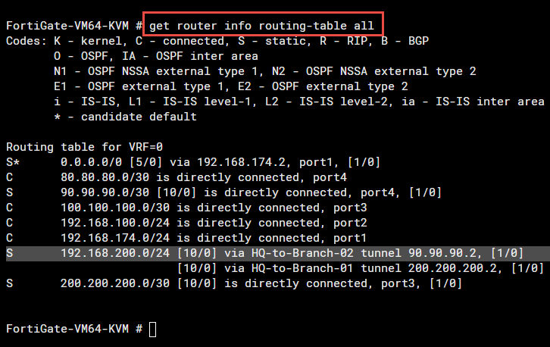
SD-WAN Routing Table
CLI Only .
Policy Route
( Policy + Route )
Based on If ….. Then …Action for forward.
Routing will apply on zone interface members.
Priority than firewall policy .
S 192.168.200.0/24 [10/0] via HQ-to-Branch-02 tunnel 90.90.90.2, [1/0]

Slide 53
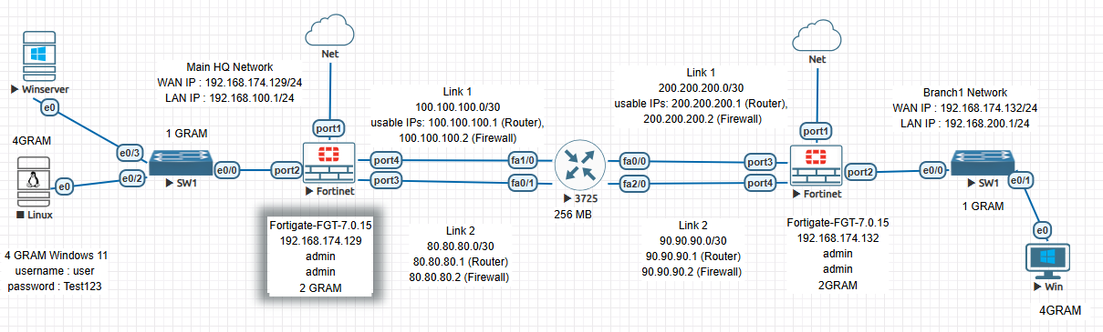
Let’s Start and test..

